Slide 1
Dynamic heterostructure文献整理
孙逸杰

Slide 2
mechanical
optical
thermal
magnetic

Slide 3
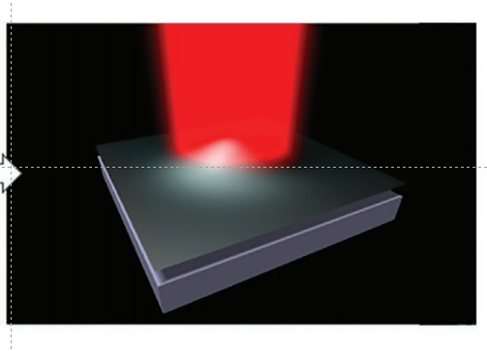
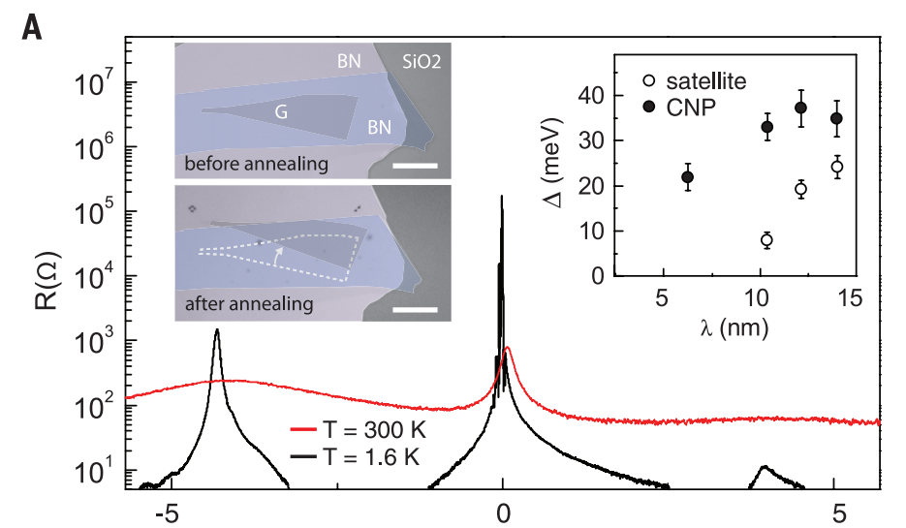
Owing to the superlubricity of vdW interfaces, moiré superlattices with dynamically controllable twist angles can be obtained through mechanical, optical, thermal, and magnetic manipulation

Slide 4
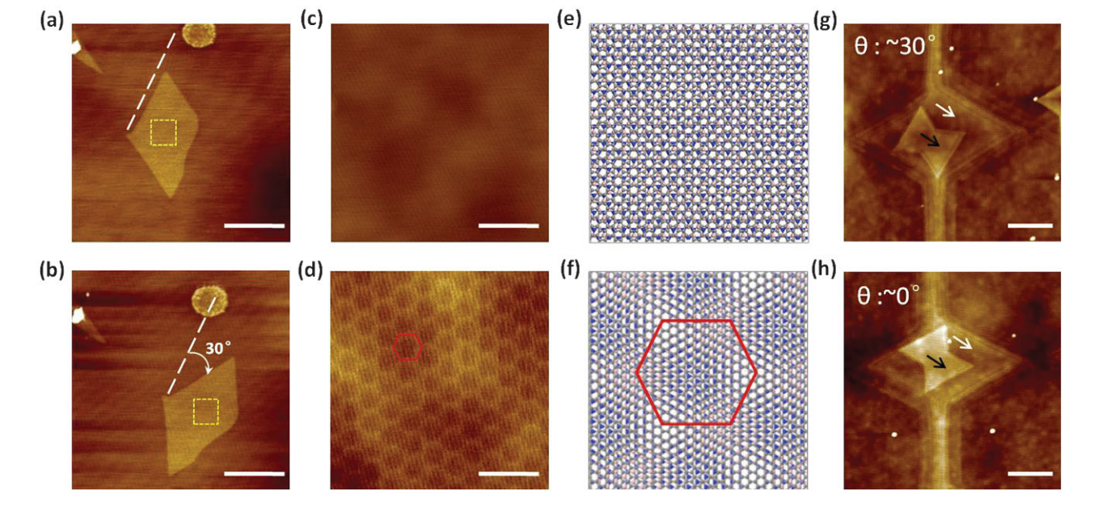
thermal
Thermally Induced Graphene Rotation on Hexagonal Boron Nitride
graphene flakes on h-BN rotate and translocate after patterning at a temperature of 450 °C.

